Slide 1
Individual Sample Registration

Slide 2
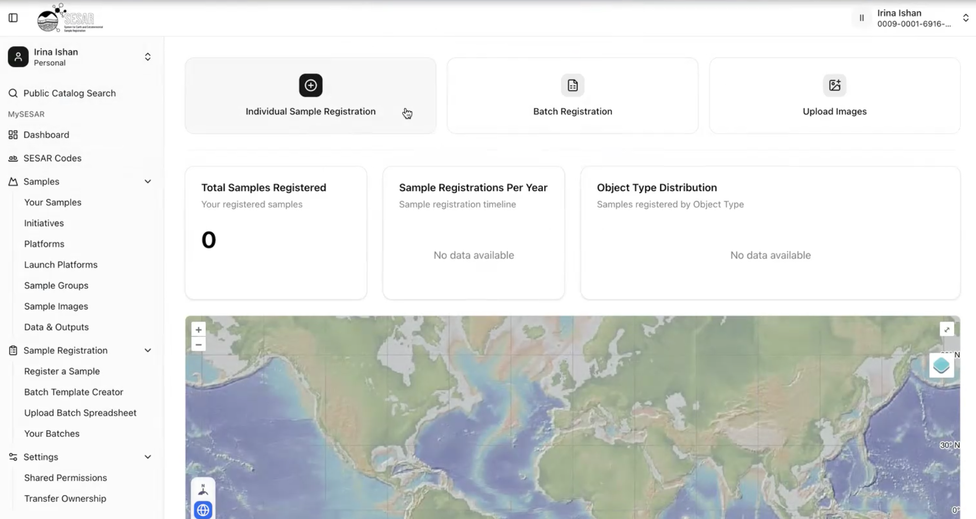
Individual Sample Registration
1
Access Individual Sample Registration on your Dashboard.
2
Access to Sample Registrations on left side panel.
Select Register a Sample.

Slide 3
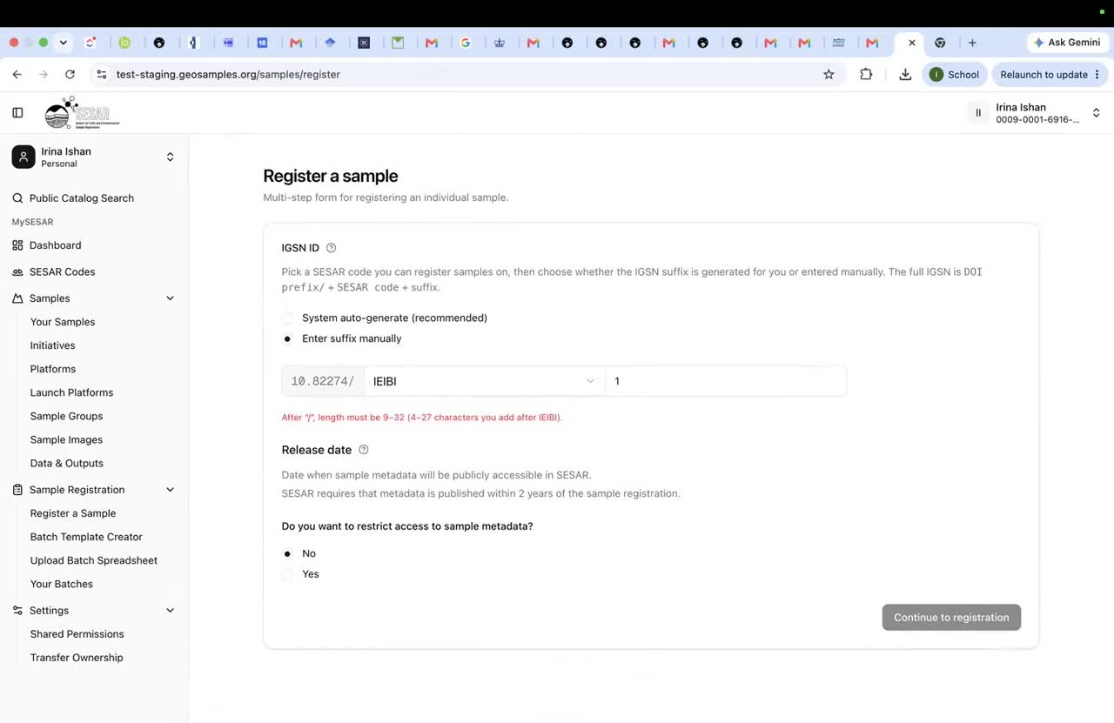
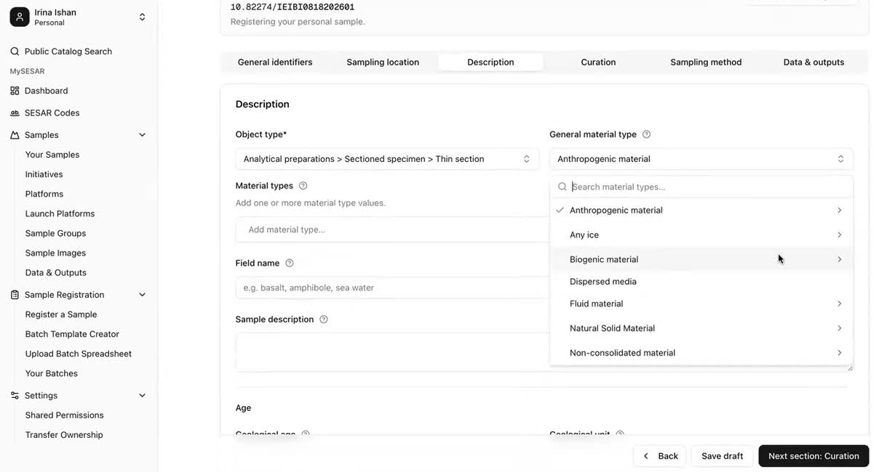
Individual Sample Registration
1
2-4
Individual registrations are for single sample registrations.
Select a SESAR Code for your sample.
Enter identifiers and required sample information.
Continue through location, classification, collection, and related fields, then submit.
Save draft if you want to finish registration at a later time.

Slide 4
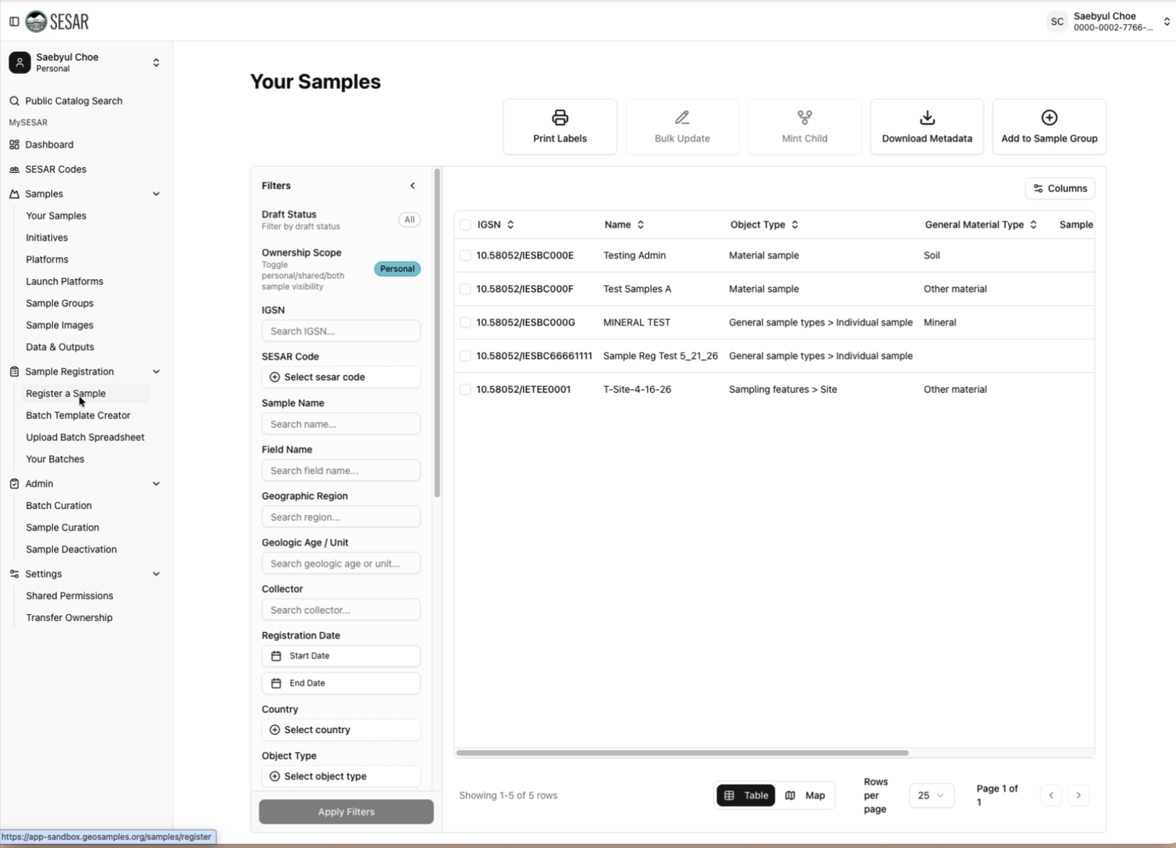
Registration - VIDEO Tutorial

Slide 5
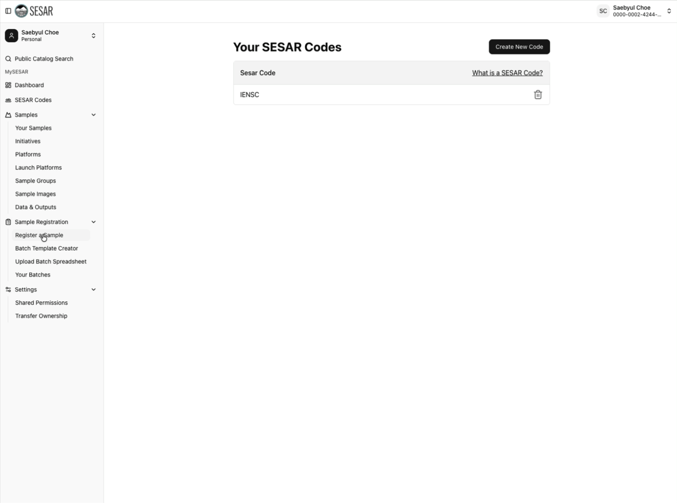
Assigning IGSNs - VIDEO Tutorial

